Slide 1
Computer Graphics: Rendering
Autumn 2024
Lecture 1: Introduction and Course Organisation
Kartic Subr

Slide 2









Me: A brief history

Slide 3
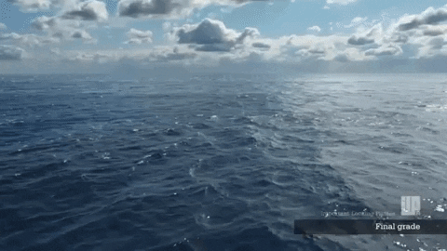
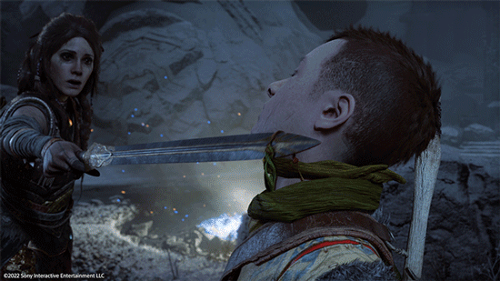
Video Games
(real-time)
Important Looking Pirates VFX
Special Effects
God of War: Ragnarok 2023

Slide 4


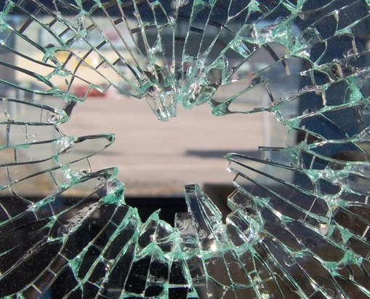

Notes:
A common goal is to develop models and simulation mechanisms that mimic reality as closely as possible. But how is this ‘closely as possible’ defined?

Slide 5
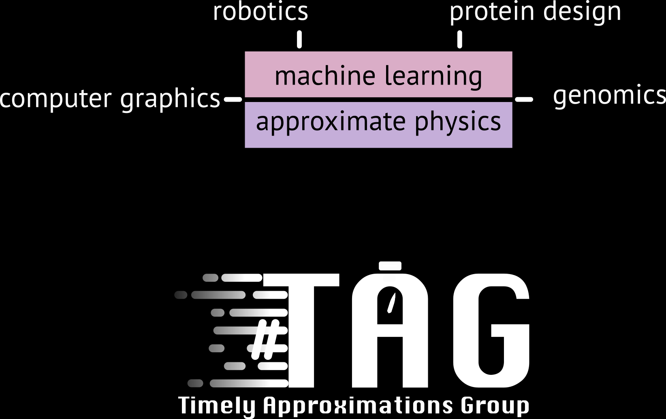
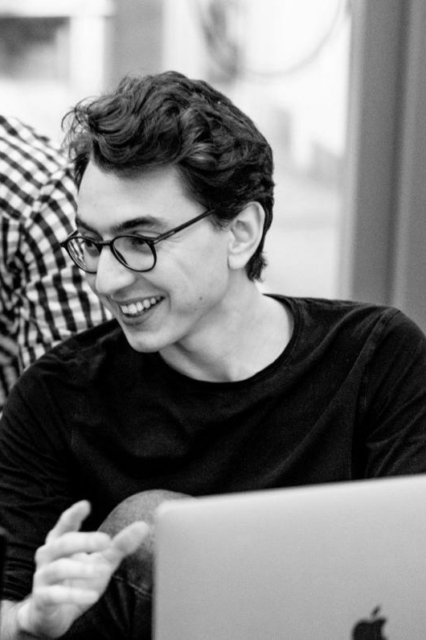
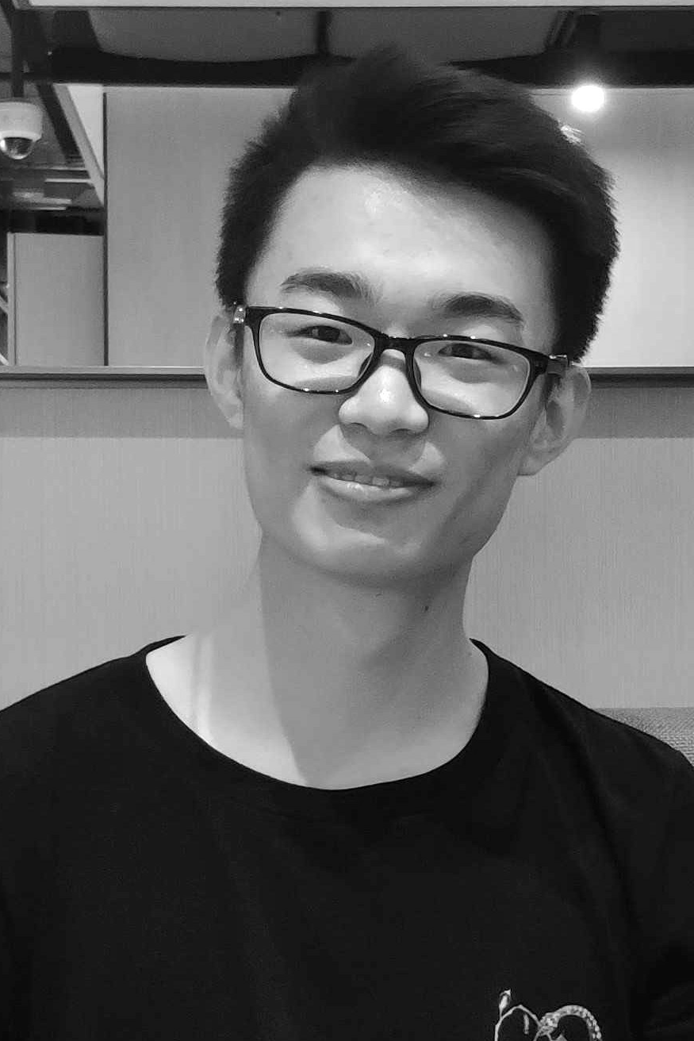
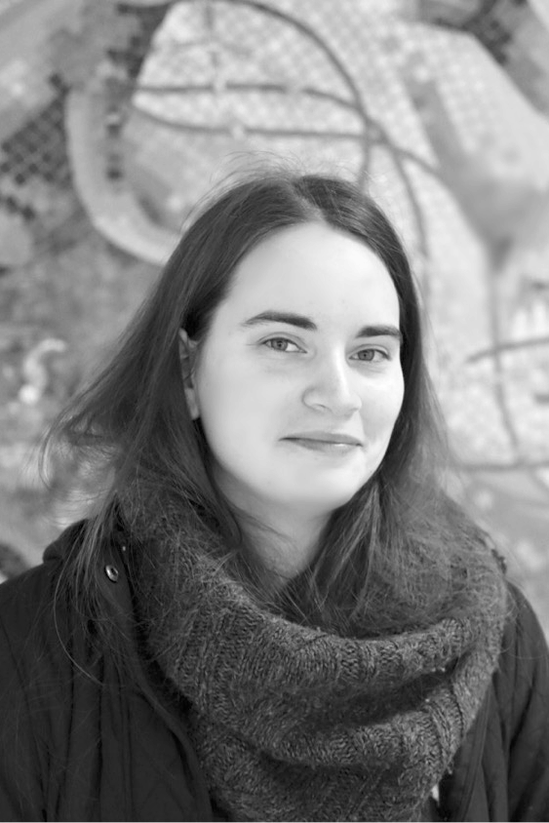
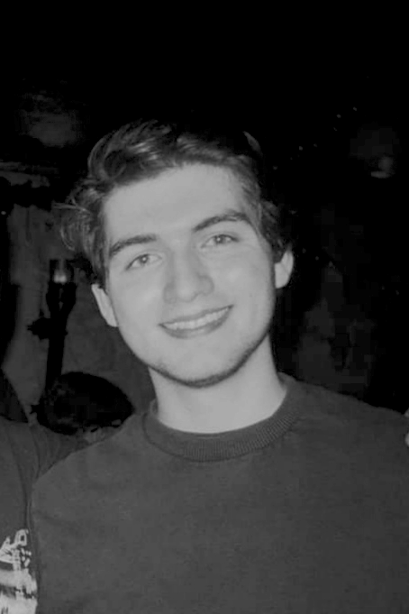
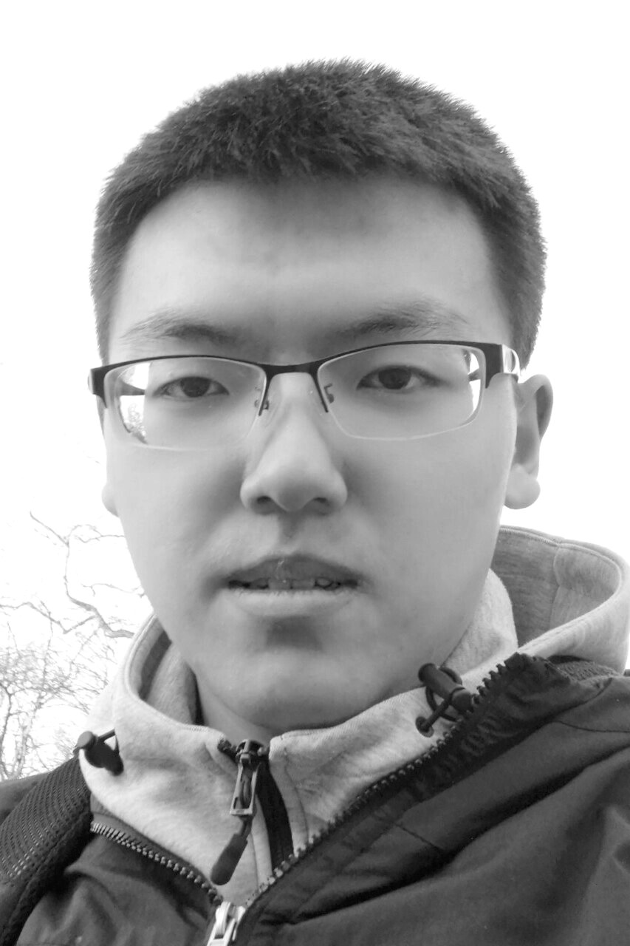


Slide 6
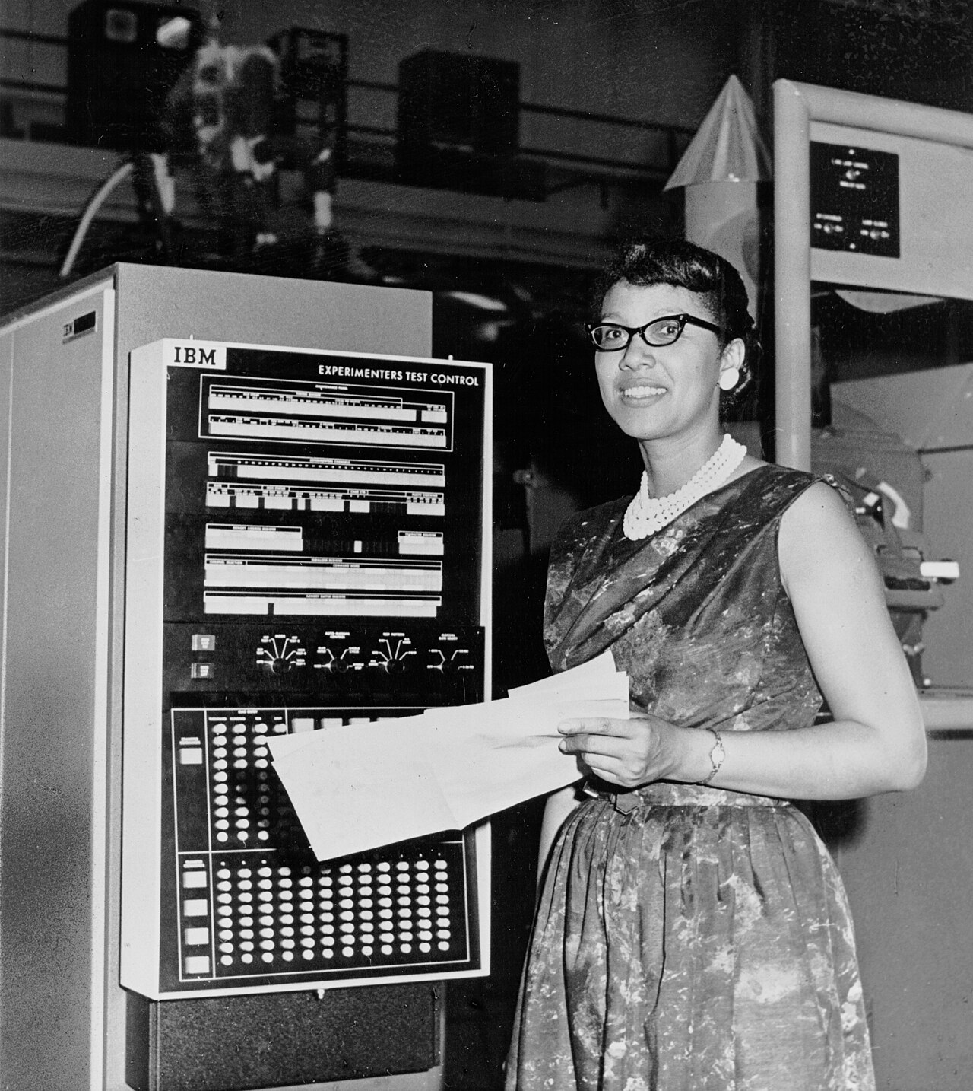

Slide 7
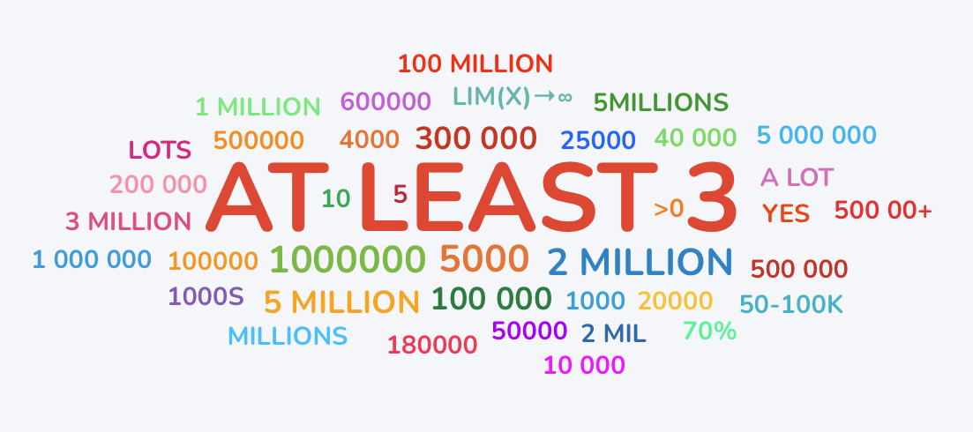

Notes:
A common goal is to develop models and simulation mechanisms that mimic reality as closely as possible. But how is this ‘closely as possible’ defined?

Slide 8
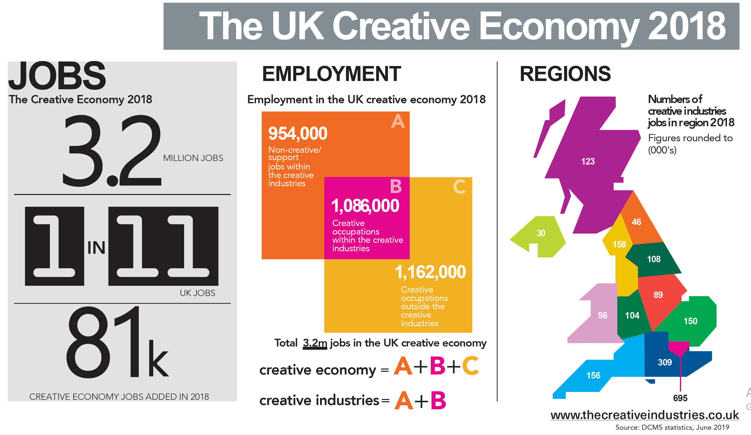
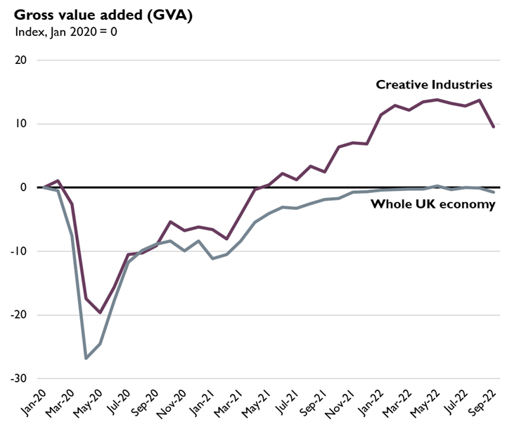
Creative Industries in the UK
https://lordslibrary.parliament.uk/arts-and-creative-industries-the-case-for-a-strategy/

Slide 9
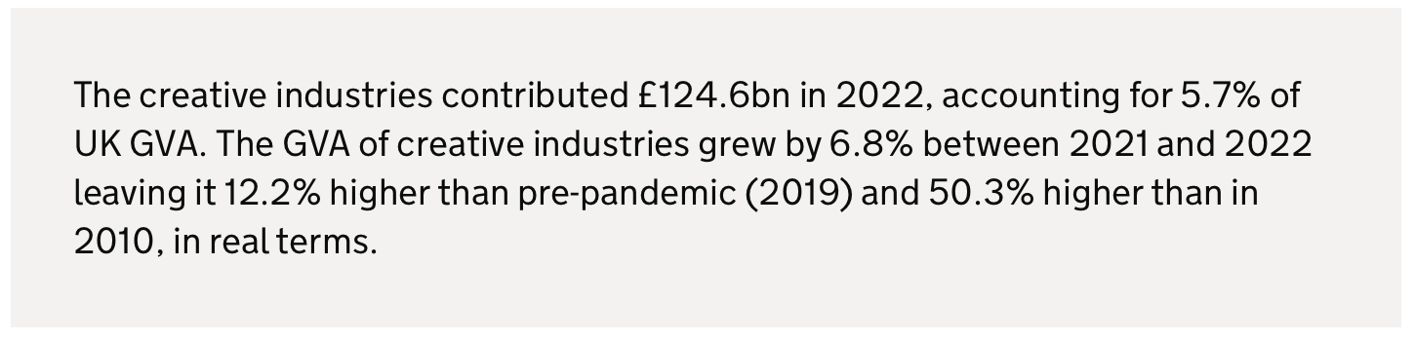
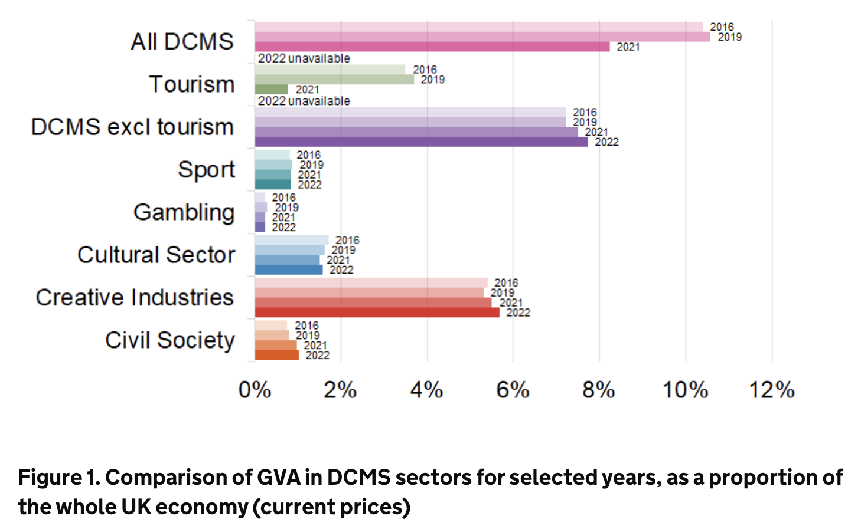
CGR is central to the creative industries
Source: DCMS report 2024

Slide 10

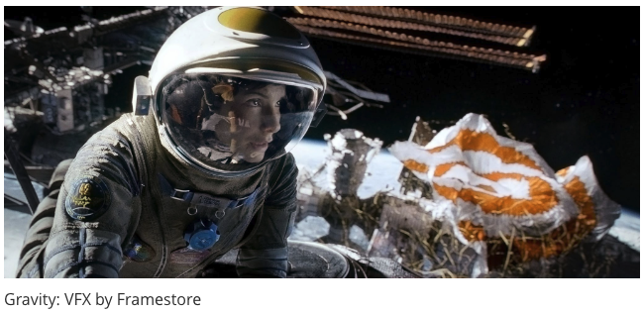
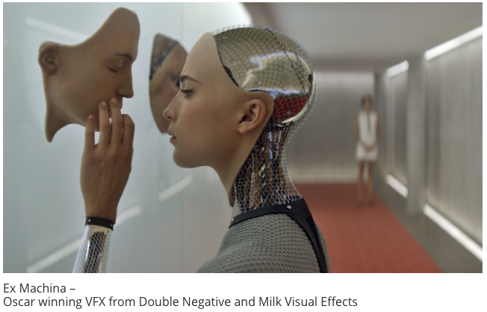
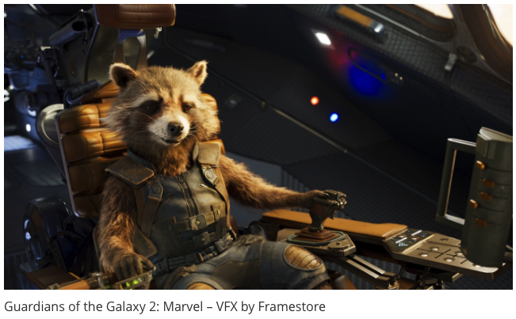

It’s all happening here in the UK!

Slide 11
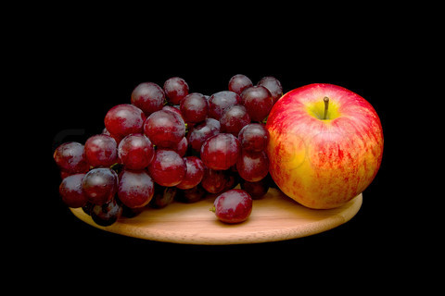
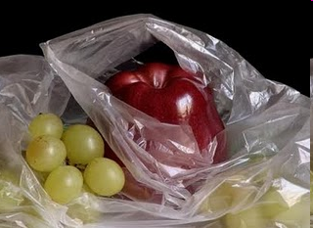

Simulating photorealistic pictures?
photograph
manually painted
computer generated
Colourbox.com
Pedro Campos

Slide 12
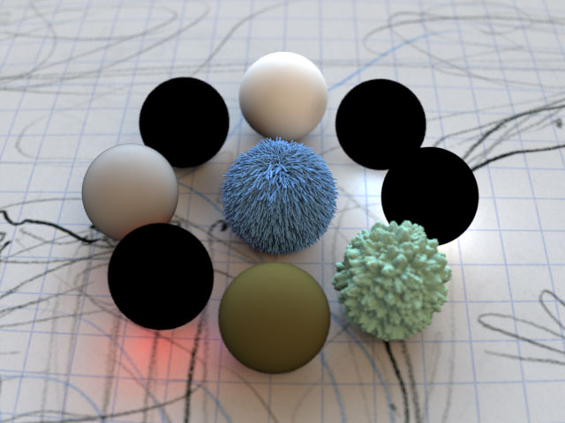
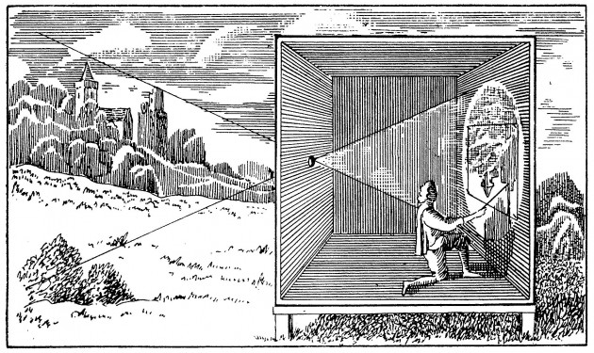
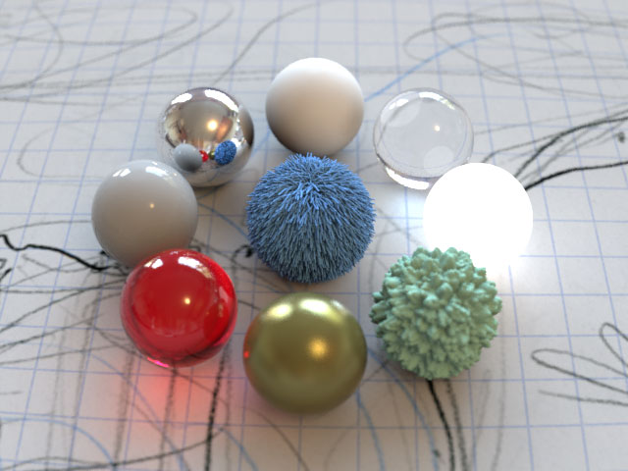
Physically based simulation, at its core!
Projective geometry
Energy
(light transport)

Slide 13
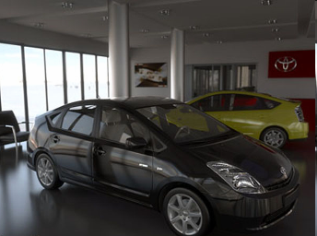
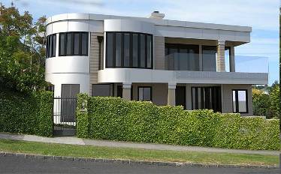
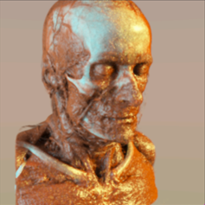
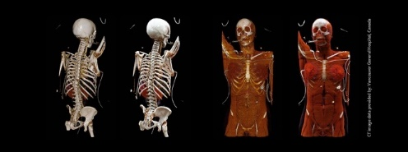
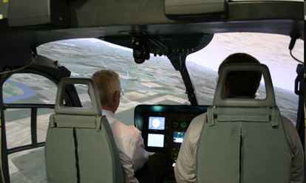
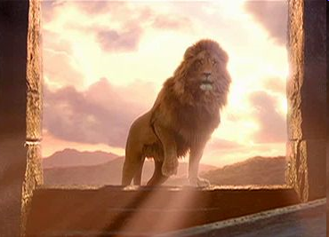
Advertising
Engineering
Medicine
Defense
Entertainment

Slide 14
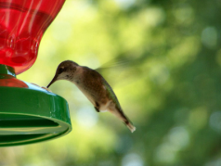


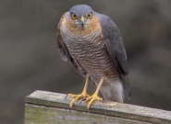

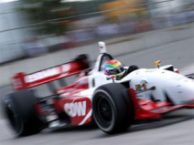

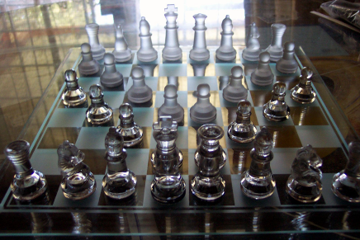
Simulate the physics of light
lenses
defocus
exposure time
light, media
materials

Slide 15
About the course …
coursework only (no exam)
2 coursework assignments: C1, C2
Final mark = C1 + C2
class split into 3 groups (for tutorials)
Tutorials provide guidance towards CW
GPT, co-pilot, Edinburgh University’s ELM (click here)

Slide 16
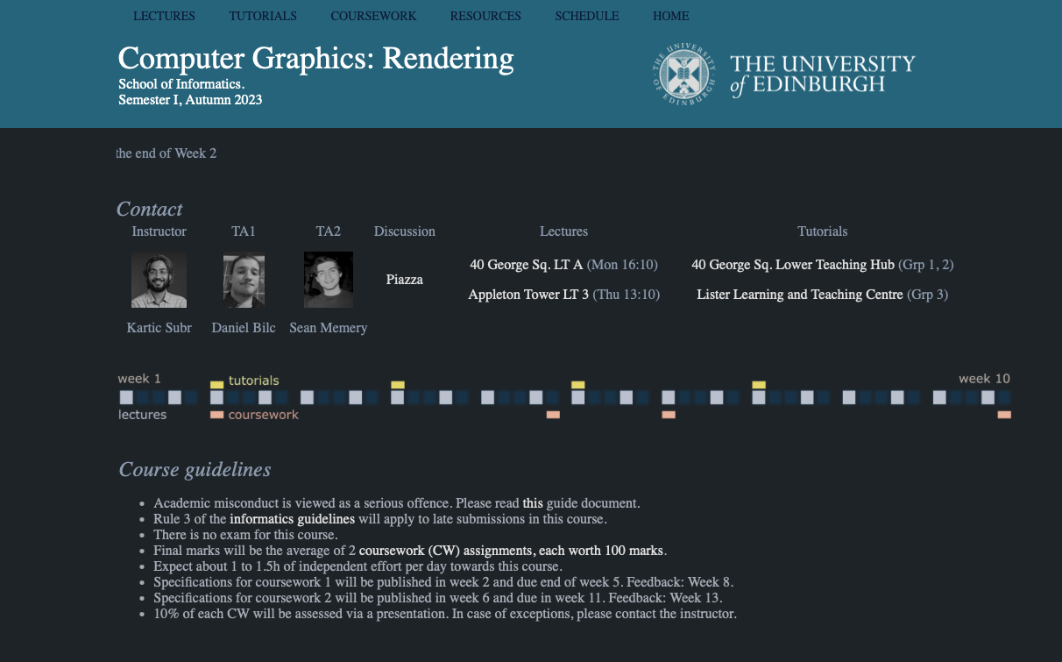
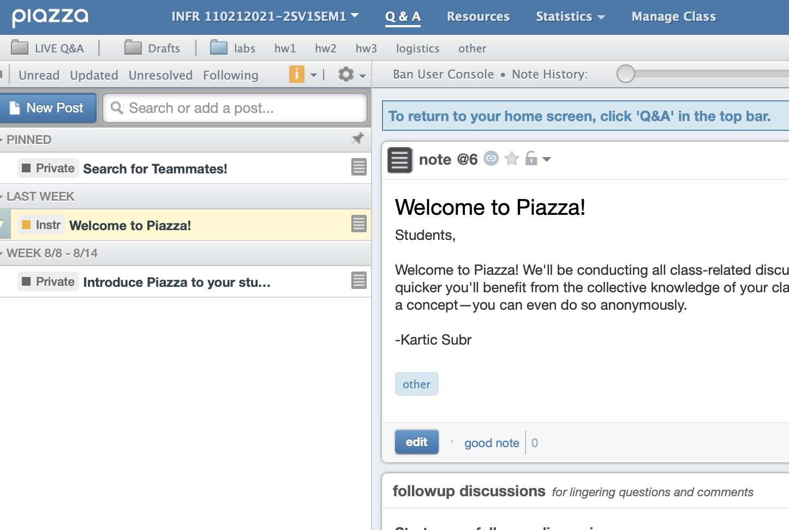
Logistics
TA and marker: Krzyzstof Gyrkiel
(took the course last year)
Course website
piazza
https://ksubr.github.io/CGR2024/

Slide 17
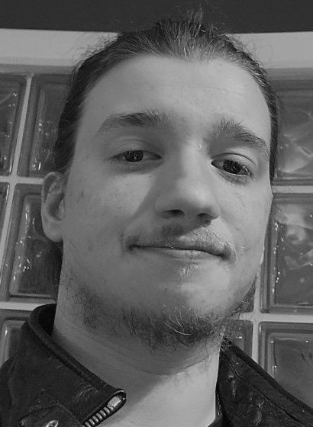
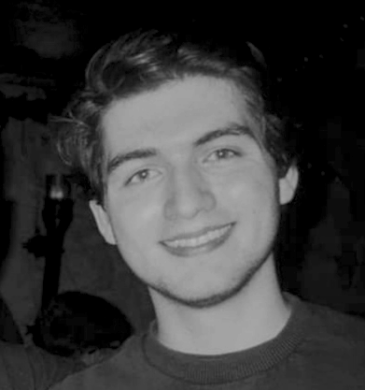
Logistics
Daniel
Sean
CW1: Daniel Bilc
CW2: Sean Memery
?
Course website
piazza
https://ksubr.github.io/CGR2023/

Slide 18
CGR
Contact hours (19h)
16h lectures
3h tutorials
Self-directed (80h)
6h creative thinking
37h CW1 (for 80%)
37h CW2 (for 70%)

Slide 19
CGR
Contact hours (19h)
16h lectures
3h tutorials
Self-directed (80h)
6h creative thinking
37h CW1 (for 80%)
37h CW2 (for 70%)

Slide 20
Main feedback/criticism previous offerings
CW1 worth too much credit
CW2: basic ray tracing took too long
CW2 timing not ideal (other coursework)
Use of Gen AI tools should not be compulsory
Much of lecture material is not applied or assessed

Slide 21
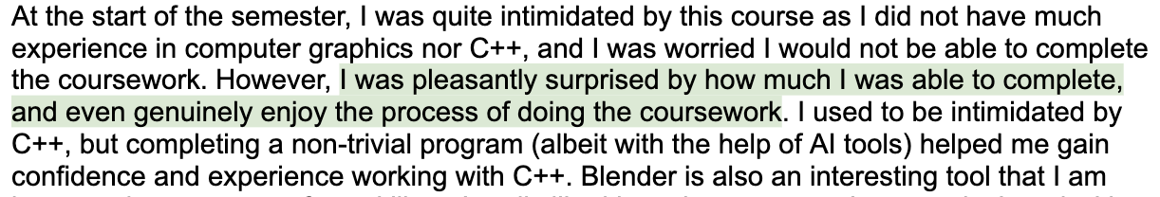
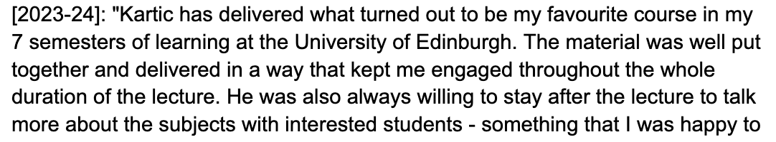
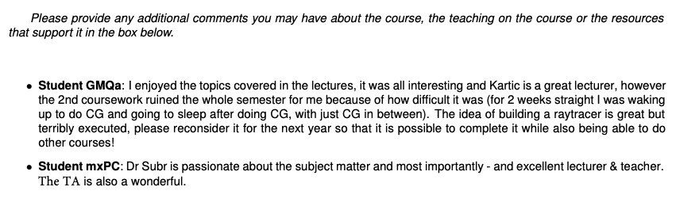
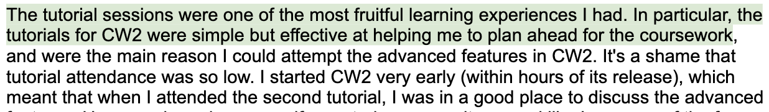
Comments …

Slide 22
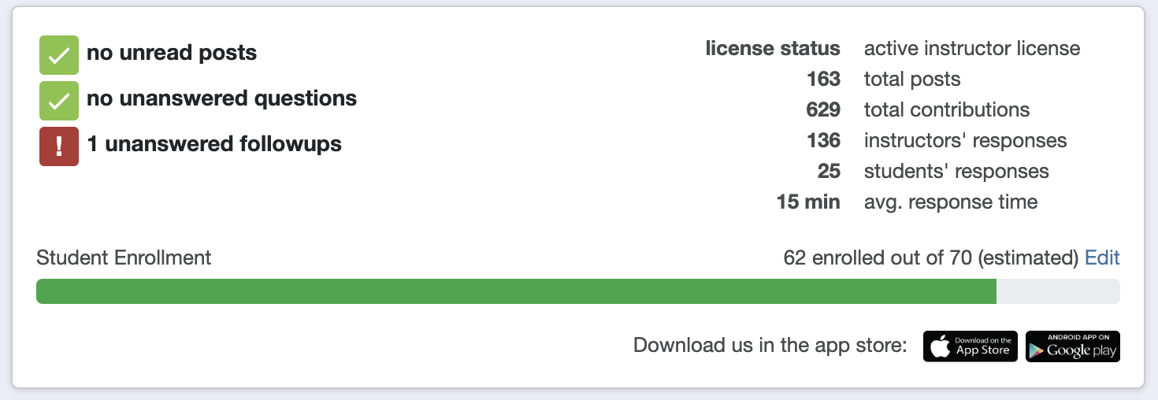
Top tips
Try to attend as many lectures as possible in-person
Work regularly – not just before deadlines
Use your opportunity to interact with the instructor
Last year

